Slide 1


CE141: COMPUTER CONCEPTS & PROGRAMMING
July – November 2018
Chapter – 3
Introduction to Programming
Devang Patel Institute of Advance Technology and Research

Slide 2


Objectives
To understand concepts of program and programming language.
To be able to choose appropriate programming languages for certain classes of programming problems.
To understand types of programming language.
To understand the significance of a compiler and interpreter.
To be able to differentiate between Procedure Oriented Language and Object Oriented Language
Chapter – 3 : Introduction to Programming

Slide 3
1-1 Programs & Programming
To write a program for a computer, we must use a computer language. Over the years computer languages have evolved from machine language to natural languages.
To use a computer language , we must know the process of creating a set of instructions that tell a computer how to perform a task. This process is known as Programming.
Chapter – 3 : Introduction to Programming

Slide 4
1-2 Programming Language
A Language that is designed to express computation that can be performed by the computer.
Programming languages are used to create the program that controls the behaviour of a system, to express algorithm, or as a mode of Human-Computer Communication.
It has a special Syntax for organizing program Instruction.
Chapter – 3 : Introduction to Programming

Slide 5
Programming language (Continued…)
The question on which language is best ? Depends on the following Factors :
The type of computer on which the program has to be executed .
The type of program
The expertise of the programmer
For Example :
FORTRAN (Used for Processing Numerical Data)
C++ (Used for Object Oriented Data Processing)
Chapter – 3 : Introduction to Programming

Slide 6
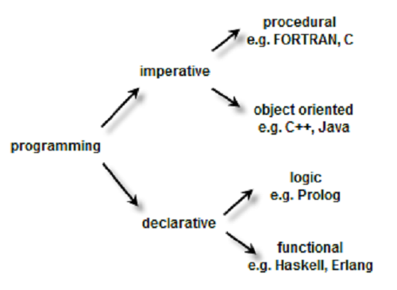
Programming language (Continued…)
Topics will be discussed in this section:
1. Machine Languages
2. Assembly Languages
3. High-Level Languages (3GL)
4. Very High-Level Languages (4GL)
5. Fifth Generation Language
Chapter – 3 : Introduction to Programming

Slide 7
Very High Level Language(1970s to 1990s)
High Level Language(1960s & 1970s)
Assembly Language(Mid of 1950s)
Fifth Generation Language(1993s)
Machine Language (1950s)
FIGURE 1-1 Programming Language Evolution
Chapter – 3 : Introduction to Programming

Slide 8
First Generation: Machine Language
Machine Language was used to program the first stored program on computer systems.
Lowest Level of programming language.
Only Language that computer understands.
All the commands and data values are expressed using 1 and 0s, corresponding to the ‘on’ and ‘off’ electrical states in a computer.
Chapter – 3 : Introduction to Programming
Chapter – 4 : Introduction to ‘C’ Language

Slide 9
Advantage Of Machine Language
Main advantage of machine language is that the code can run very fast and efficiently, since it is directly executed by the CPU.
Chapter – 3 : Introduction to Programming
Chapter – 4 : Introduction to ‘C’ Language

Slide 10
Disadvantages Of Machine Language
Machine Language is difficult to learn and edit if error occurs.
If one wants to add instructions into memory at some location, then all the instructions after the insertion point would have to be moved down to make room in memory to accommodate the new instructions.
Code written in machine language is not portable across systems.
To transfer the code to a different computer it needs to be completely rewritten since the machine language for one computer could be significantly different from another computer.
Chapter – 3 : Introduction to Programming
Chapter – 4 : Introduction to ‘C’ Language

Slide 11
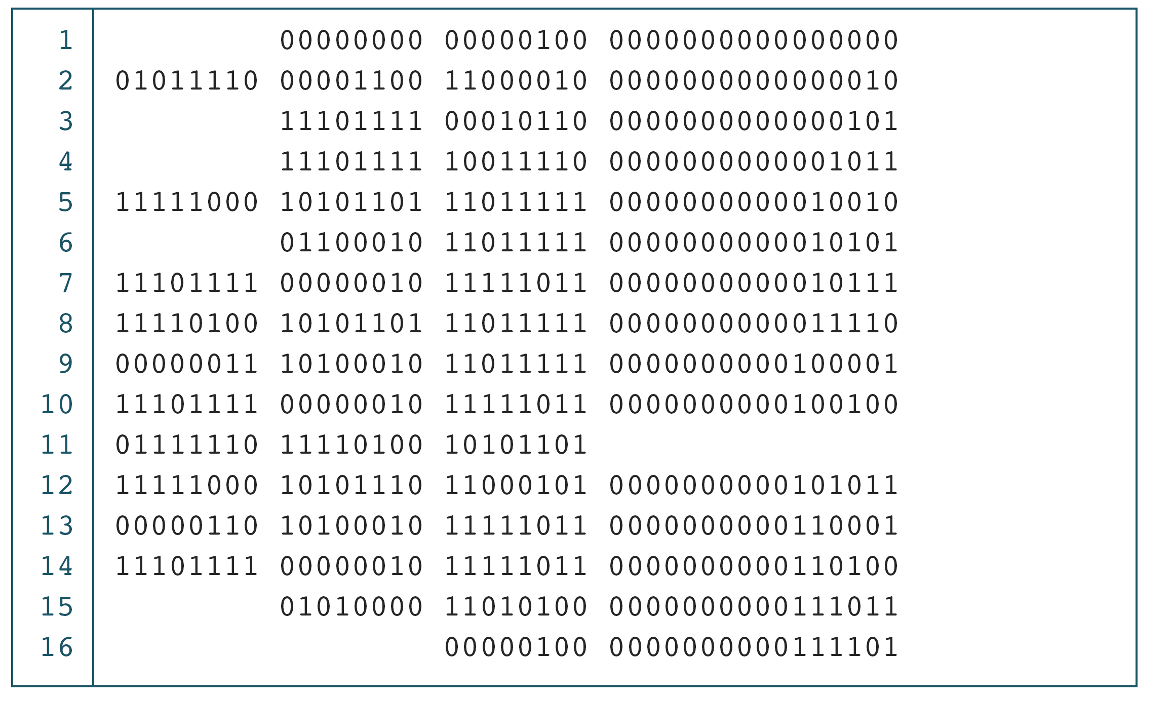
PROGRAM 1-1
The Multiplication Program in Machine Language
Chapter – 3 : Introduction to Programming
Chapter – 4 : Introduction to ‘C’ Language

Slide 12
Note
The only language understood by computer
hardware is machine language.
Chapter – 3 : Introduction to Programming
Chapter – 4 : Introduction to ‘C’ Language

Slide 13
Second Generation: Assembly Language
Assembly languages are symbolic programming languages that use symbolic notation to represent machine instructions.
They are closely connected to machine language.
As a result they are also called low-level languages.
It uses symbolic code called mnemonics .e.g. ADD, MUL.
Basically it consists of a label, an operation code and one or more operands.
The assembly language programs need a translator or assembler to convert them into machine language.
Chapter – 3 : Introduction to Programming
Chapter – 4 : Introduction to ‘C’ Language

Slide 14
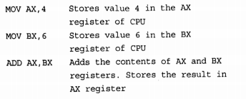
Example of addition using Assembly Language
Chapter – 3 : Introduction to Programming
Chapter – 4 : Introduction to ‘C’ Language

Slide 15
Advantages of Assembly Language
The code written in assembly language will be very efficient in terms of execution time and main memory usage as the language is also close to the computer.
Much better to program as compared to machine language.
Chapter – 3 : Introduction to Programming
Chapter – 4 : Introduction to ‘C’ Language

Slide 16
Disadvantage of Assembly Language
Require the programmer to think on the machine’s level.
Chapter – 3 : Introduction to Programming
Chapter – 4 : Introduction to ‘C’ Language

Slide 17
PROGRAM 1-2
The Add Program in Assembly Language
Opr1 dw 1234h
Opr2 dw 0002h
Mov ax, opr1
Mov bx, opr2
Add ax,bx
Chapter – 3 : Introduction to Programming
Chapter – 4 : Introduction to ‘C’ Language

Slide 18
Note
It used Symbolic codes , that are easy to remember rather than numbers.
Chapter – 3 : Introduction to Programming
Chapter – 4 : Introduction to ‘C’ Language

Slide 19
Third Generation Programming languages
A refinement of the second generation programming languages.
The third generation was introduced to make the languages more programmer friendly.
In these languages, the program statements are not closely related to the internal architecture of the computer and is therefore often referred to as high-level languages.
High-level languages fall somewhere between natural languages and machine languages.
E.g. FORTRAN (FORmula TRANslator) and COBOL (COmmon Business Oriented Language).
Chapter – 3 : Introduction to Programming
Chapter – 4 : Introduction to ‘C’ Language

Slide 20
Advantages of Third Generation Languages
The third generation languages have made it easier to write and debug programs, which gives programmers more time to think about its overall logic.
Programs written in such languages are portable between machines.
E.g., A program written in standard C can be compiled and executed on any computer that has a standard C compiler.
Chapter – 3 : Introduction to Programming
Chapter – 4 : Introduction to ‘C’ Language

Slide 21
Disadvantage of Third Generation Languages
They do not provide the flexibility available in low-level languages.
Chapter – 3 : Introduction to Programming
Chapter – 4 : Introduction to ‘C’ Language

Slide 22
PROGRAM 1-3
The Multiplication Program in C using High Level Language
#include <stdio.h>
void main()
{
int number1,number2,answer;
clrscr();
printf (“Enter two number:”);
scanf(“%d %d” , number1,number2);
answer = number1*number2;
printf(“Answer : %d”, answer);
getch();
}
Chapter – 3 : Introduction to Programming
Chapter – 4 : Introduction to ‘C’ Language

Slide 23
Note
The program written in such a languages are portable between machines .
For Example , a program written in “Standard C“ can be compiled and executed on any computer that has a Standard C Compiler .
Chapter – 3 : Introduction to Programming
Chapter – 4 : Introduction to ‘C’ Language

Slide 24
Fourth Generation: Very High-level languages
Little different from its prior generation languages because they are basically non-procedural.
While using non-procedural language, the programmers define only what they want the computer to do, without supplying all the details of how it has to be done.
Chapter – 3 : Introduction to Programming
Chapter – 4 : Introduction to ‘C’ Language

Slide 25
Characteristics of 4GL
The code comprising instructions are written in English-like sentences.
They are non-procedural, so users concentrate on ‘what’ instead of ‘how’ aspect of the task.
The code is easier to maintain.
The code enhances the productivity of the programmers as they have to type fewer lines of code to get something done.
Chapter – 3 : Introduction to Programming
Chapter – 4 : Introduction to ‘C’ Language

Slide 26
Advantage of 4GL
4GL is much simpler to learn and work with.
Chapter – 3 : Introduction to Programming
Chapter – 4 : Introduction to ‘C’ Language

Slide 27
Disadvantage of 4GL
It does not make efficient use of the machine’s resources.
Chapter – 3 : Introduction to Programming
Chapter – 4 : Introduction to ‘C’ Language

Slide 28
PROGRAM 1-4
The Program in Very High Level Language
Table : Department
Department Id | Department Name
01 | CSE
02 | CE
03 | IT
04 | Mechanical
Query :
Select * From Department ;
Chapter – 3 : Introduction to Programming
Chapter – 4 : Introduction to ‘C’ Language

Slide 29
Note
The code comprising instructions are written in English like Sentences.
Chapter – 3 : Introduction to Programming
Chapter – 4 : Introduction to ‘C’ Language

Slide 30
Fifth Generation Programming Languages
Centered on solving problems using constraints given to the program, rather than using an algorithm written by a programmer.
Widely used in Artificial Intelligence research.
E.g. Prolog, OPS5 and Mercury.
It contains visual tools to help develop a program. E.g. Visual Basic.
Chapter – 3 : Introduction to Programming
Chapter – 4 : Introduction to ‘C’ Language

Slide 31
Advantages of 5GL
Designed to make the computer solve a given problem without the programmer.
With 5GL, the programmer only needs to worry about what problems need to be solved and what conditions need to be met, without worrying about how to implement a routine algorithm to solve them.
Chapter – 3 : Introduction to Programming
Chapter – 4 : Introduction to ‘C’ Language

Slide 32
Disadvantage of 5GL
Starting from a set of constraints for defining a particular problem, then deriving an efficient algorithm to solve the problem is a very difficult task.
Chapter – 3 : Introduction to Programming
Chapter – 4 : Introduction to ‘C’ Language

Slide 33


Fifth Generation Language
Contain Visual tools to help develop program.
Used for Artificial Intelligence
Example : Visual Basic, Prolog, OPS
Prolog Example
Chapter – 3 : Introduction to Programming
Chapter – 4 : Introduction to ‘C’ Language

Slide 34
Note
It Solve problem using constraints given to the program ,rather than using an algorithm written by the programmer.
Chapter – 3 : Introduction to Programming
Chapter – 4 : Introduction to ‘C’ Language

Slide 35
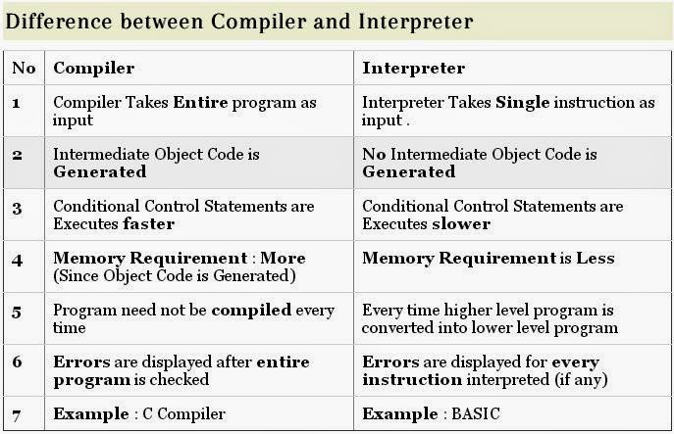
1-3 Compiler & Interpreter
Chapter – 3 : Introduction to Programming
Chapter – 4 : Introduction to ‘C’ Language

Slide 36
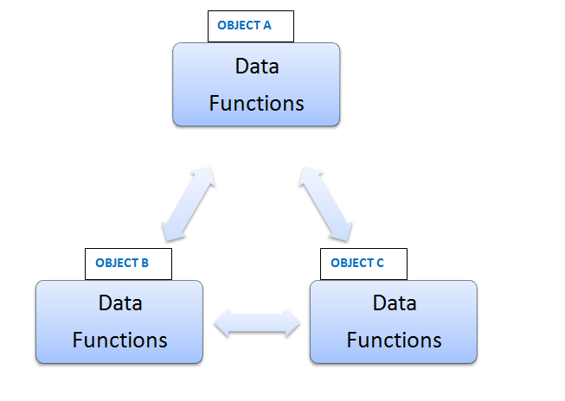
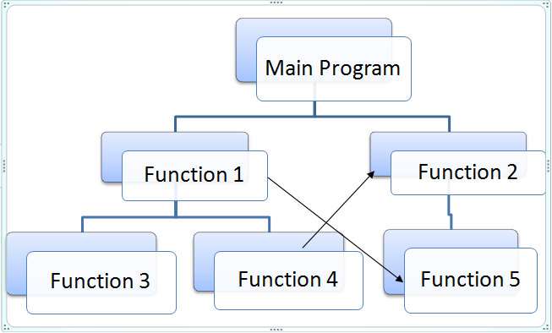
1-3 Difference between Object Oriented
Programming(OOP) and Procedural Oriented
Programming (POP)
OOP
POP
Chapter – 3 : Introduction to Programming
Chapter – 4 : Introduction to ‘C’ Language

Slide 37
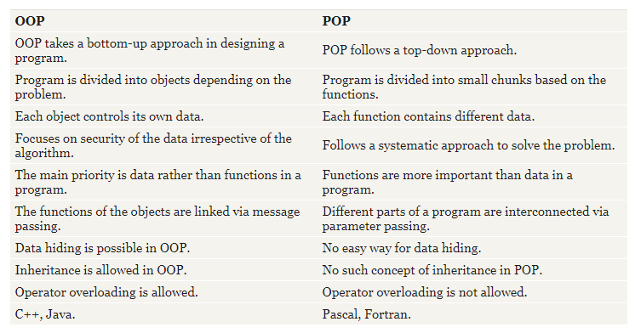
1-3 Difference between Object Oriented
Programming(OOP) and Procedural Oriented
Programming (POP) Continued…
Chapter – 3 : Introduction to Programming
Chapter – 4 : Introduction to ‘C’ Language

Slide 38
Questions from previous year papers
What is the importance/ significance of C Language?
(2 Marks)
Write advantages of C Language. (2 Marks)
Write down advantages of OOP over POP. (3 Marks)
How to decide which programming language should we opt? (2 Marks)
Chapter – 3 : Introduction to Programming
Chapter – 4 : Introduction to ‘C’ Language

Slide 39

Computer Science: A Structured Programming Approach Using C

